Slide 1
BlackJack2018 NoName
Markus Heino
Jussi Jokio
Juhana Poikela

Slide 2

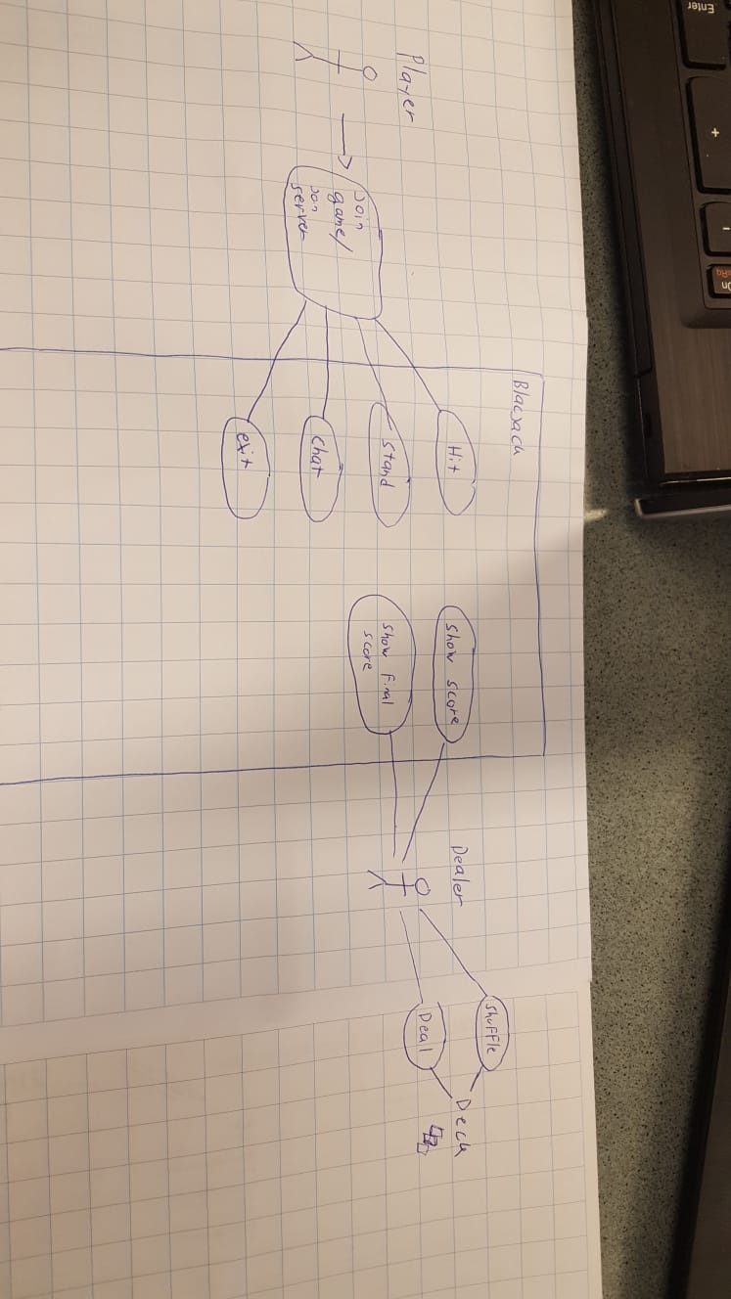




Use case diagram

Slide 3
Use case scenario
Matti is a user that wants to play some blackjack, but still have some deep conversations with other people. The priority is having conversation, but most importantly get answer right away and to play the game meanwhile while waiting for answers.
Matti has chose to play BlackJack2018, that we have developed. First he has to join our server. This automatically connects him/her to the table and he can participate on the next run. If the table has a spot Matti will be able to participate as soon as next run starts.
When the turn starts Matti, but also any other players gets 2 cards. Here the game is using rules of a blackjack. Matti does see also one card from the Dealer, the second card is shown when, everyone has ended their individual turns.
At this point Matti is also able to chat with other players. Chatting is possible at any times no matter if its Matti’s turn or not. Matti is not able to do anything else while waiting own turn. When theturn comes Matti is able to either Hit or Stand. The only other option is to leave the game, which means that the system will play Matti’s turn automatically using server’s given instructions.
If Matti hits he gets third card, and he is given the same options as long as he do not bust (over 21). When Matti stands or bust the game moves on and gives turn to next player. After everyone has ended their turns, the dealer will play own hand and players are either winning or losing depending, which one has closer to 21 (+ other blackjack rules).
New run starts, and everything start all over again except the chat that has everything stored in it so the conversation logs will stay there as long as the server is running.

Slide 4
Tasks
Design the game and its mechanics
Frontend, backend and API’s
Well commented code
Testing
Documenta´tion

Slide 5
Project structure
Agile method is being used for development
Weekly meetings (sprints)
Shared workload

Slide 6
Tools
Frontend
JS, Html5.(angularjs)
Backend & API
C#,.Netframework
Azure

Slide 7
Thank you
For your time and interest
Markus Heino
Jussi Jokio
Juhana Poikela

